Slide 1


Smart Stock
Inventory Optimization for
Retail Stores
ENHANCING BUSINESS EFFICIENCY THROUGH STREAMLINED STOCKS.
Vaishnavi Potu
Sivateja Somisetty
Hephzibai
Sahithya Kedala
-

Slide 2
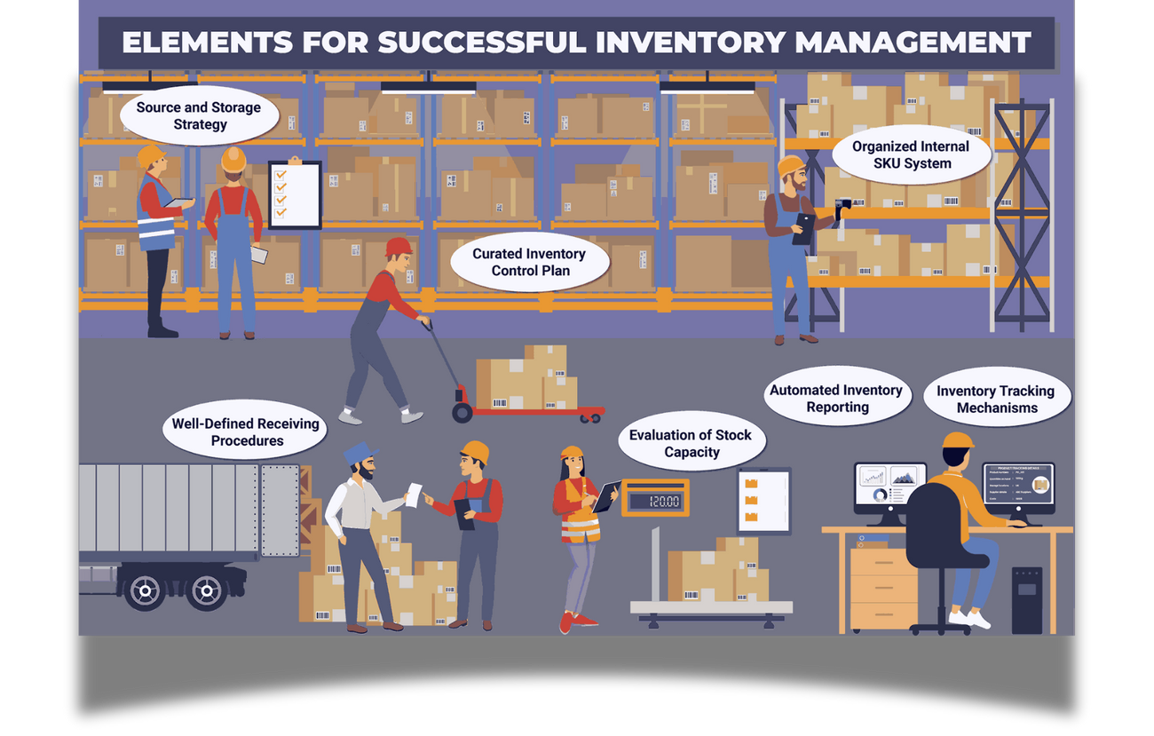
INTRODUCTION
In today’s competitive retail environment, efficient inventory management is essential for maximizing profitability and customer satisfaction.
This project introduces a Smart Inventory Optimization System that uses data analytics and machine learning to predict product demand and optimize stock levels.
This software-based system reduces manual effort, making it a practical and scalable solution for modern retail management.

Slide 3
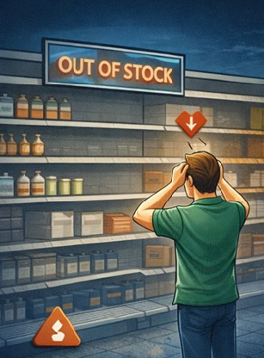



Problem Statement
Frequent stock-outs-Lost sales and customer dissatisfaction
2.Overstocking- Increased holding costs and product wastage
3.Manual inventory tracking- Time-consuming and error-prone
4.Inaccurate demand forecasting- Lack of data-driven analysis

Slide 4

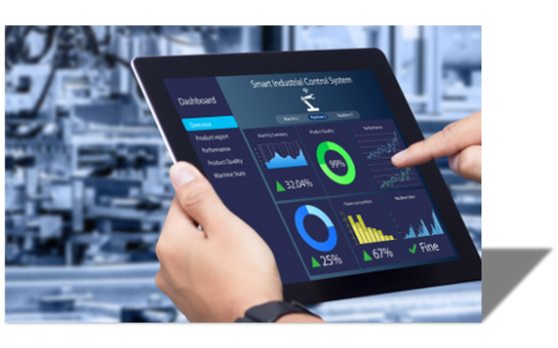
Smart Solutions
The system continuously monitors inventory levels and applies predefined stock thresholds derived from historical sales data.
A machine-learning demand forecasting model predicts future sales and identifies potential stock-out risks in advance.
Real-time dashboard alerts enable proactive restocking, reducing lost sales and ensuring better product availability.
Maintaining the perfect balance in stock levels.

Slide 5
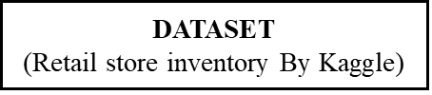

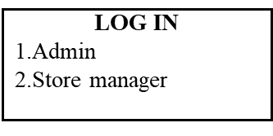
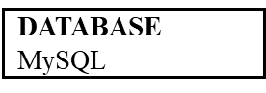

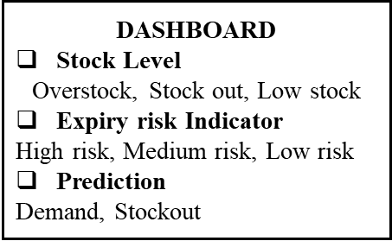
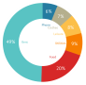
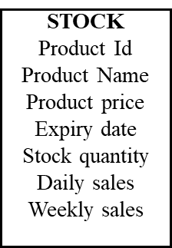
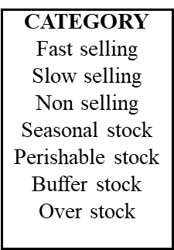
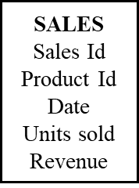
System Architecture
User Schema: Secure role-based management for Admins and Store Managers.
Product Schema: Comprehensive SKU tracking including city and store identifiers.
Sales Schema: Historical transaction data mapped to time-series sequences.

Slide 6
Technology Stack
FRONTEND
BACKEND
DATA & AI
INTELLIGENCE
ReactJs
Python
Prophet (Forecasting)
XGBoost ML model for precise time-series sales forecasting.
Firebase
FastAPI
MySQL (Database)
Scikit-Learn
NumPy
Recharts
Efficient Data Fetching
Material UI
SQLAlchemy
Task Scheduler

Slide 7

Database Schema MySQL
Users- User Id, Role , store_id, Gmail
Inventory Data- id, date , store_id , product_id , category , region, price
discount , competitor_pricing ,inventory_level , units_ordered , demand_forecast, holiday_promotion, weather_condition , seasonality, units_sold , city, store_name , product_name
Sales Records- Historical sales data for Model traning.
Optimized storage for faster order fulfillment.

Slide 8


Authentication
API & Authentication Architecture-
Backend API Framework: FastAPI
Authentication & Security-
Authentication Service: -
Firebase Authentication
Role-Based Access Control
Admin Role- Full access to all application pages
Store Manager Role- Restricted access based on assigned store ID

Slide 9
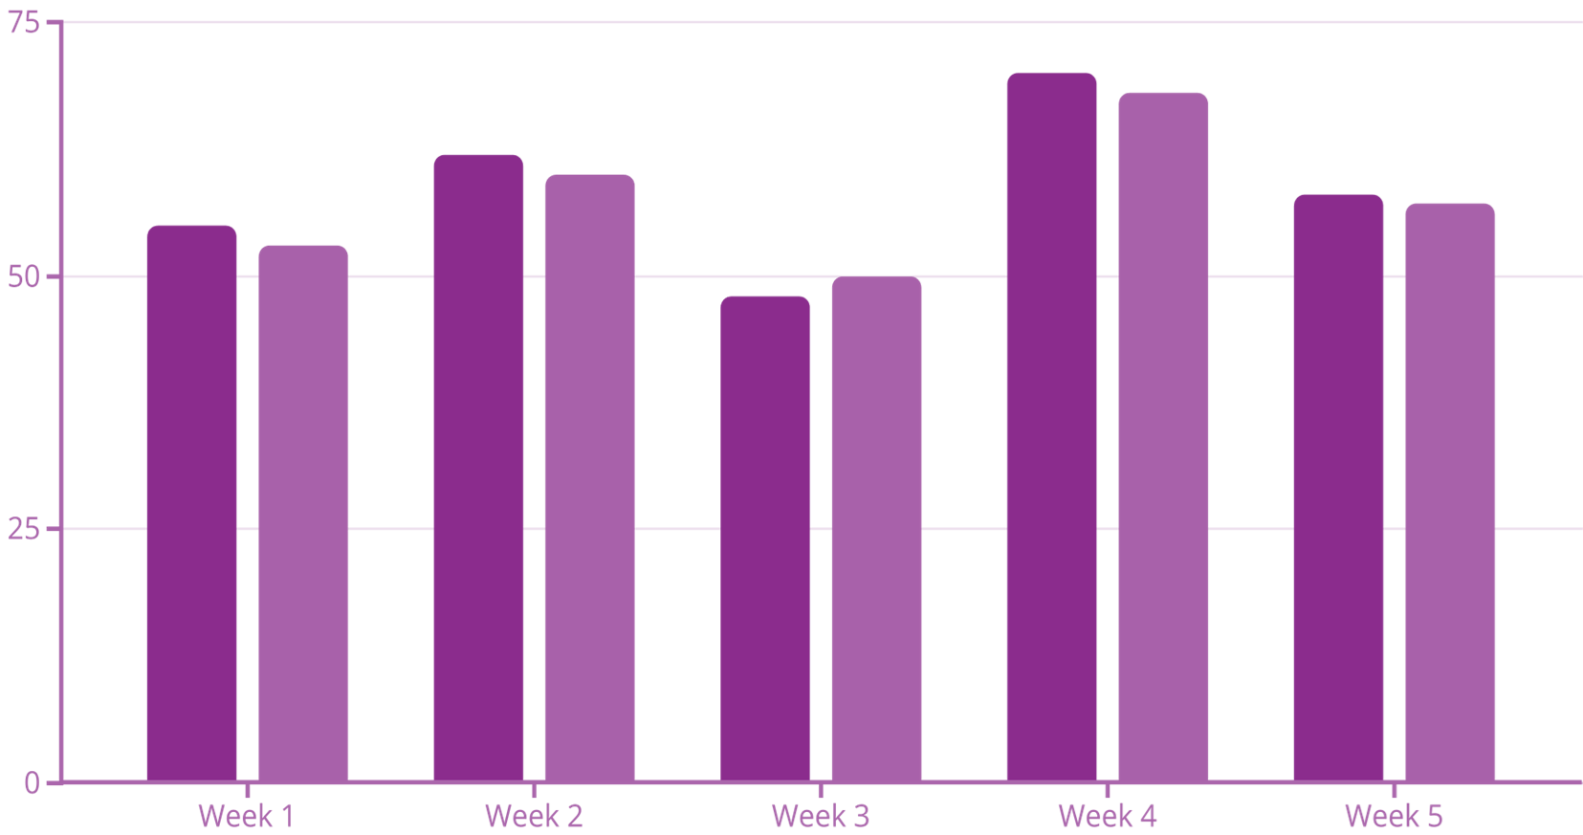

Trained Forecast Model
Model Training: The XGBoost Powerhouse
n_estimators=300: Number of boosting rounds.
•max_depth=10: Maximum depth of each tree.
•learning_rate=0.1: Step size shrinkage to prevent overfitting.
By leveraging Extreme Gradient Boosting, our system identifies non-linear sales patterns that traditional models miss.
The model processes historical sales volume, seasonality, and localized trends to predict future demand with over 92% accuracy.

Slide 10
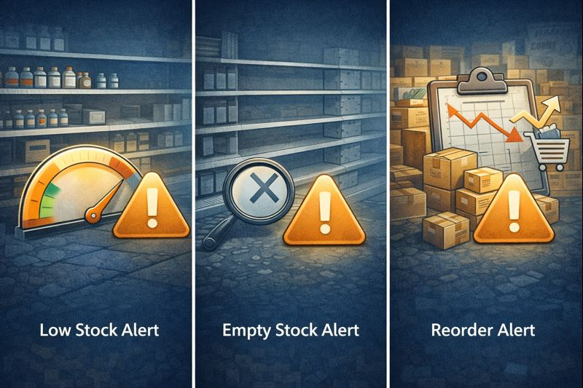

INVENTORY ALERTS
Low Stock Alert
Empty Stock Alert
Reorder Alert.
Alert = Predicted Sale > Inventory
The system suggests reorder for Low and Empty stock

Slide 11
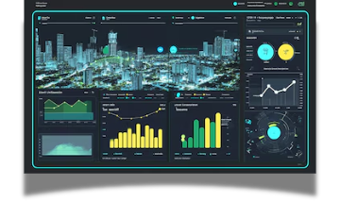
City Dashboard
City Selection
All Stores in City
Unique store Id
Store-wise Sales Data
City Dashboard Insights

Slide 12


Future Scope
Automated Best Supplier Identification
Integration with Email and SMS Alerts

Slide 13
BUILDING A FUTURE OF EFFICIENT AND SUSTAINABLE STOCKS.
Thank
You..
-

